Slide 1

Communications Update
Communications Update: January Ops Board
This communications update looks at the communication activity delivered across the V&V Partnership, where the activity mirrors the aims of the VVU and supports prevention messages around the priority themes of violence, drugs, knife crime and exploitation.
The update reflects the breadth of activity across Southend, Essex and Thurrock and demonstrates the success of taking a partnership approach – be this through supporting, amplifying or sharing content across channels – to ensure more people across the county are aware of the issues we campaign against.

Slide 2

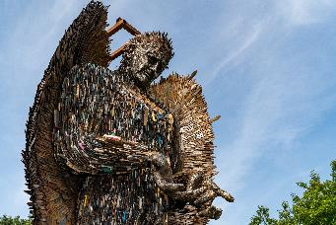
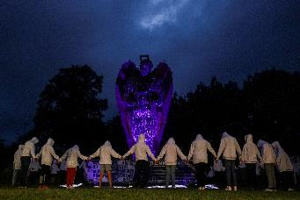
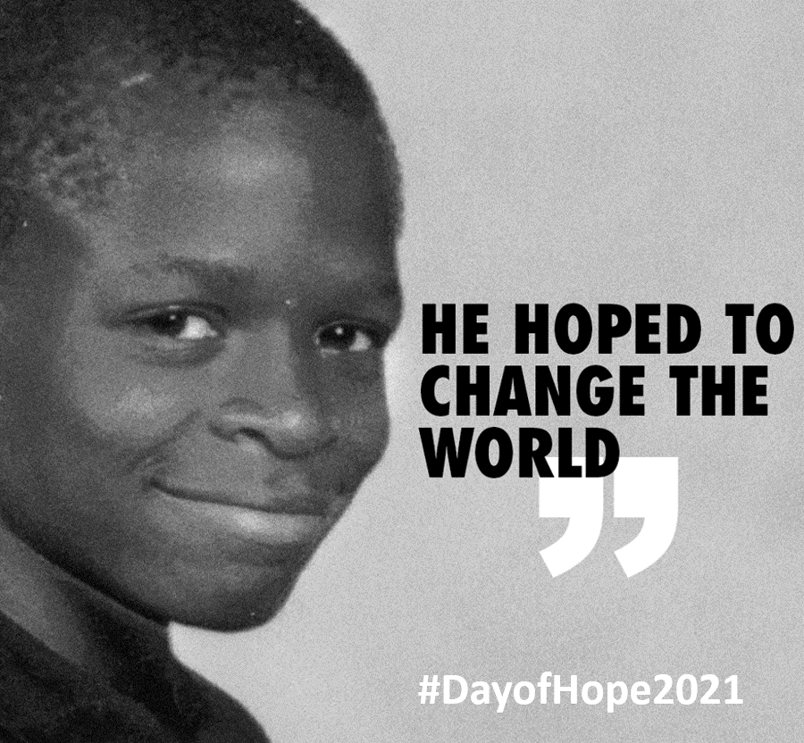
Reflecting on April to December 2021
Violence and Vulnerability Unit
Corporate piece on County Lines campaign: social media; PR, newsletters (supported by the partnership) (May)
Cuckooing awareness and education piece: website; training PR and case study use (May)
www.essexvvu.co.uk website launch (June)
V&V Community Safety Grant launch and awards made to successful groups: PR and social media (August)
Knife Angel visit (partnership): PR, social media, events (Sept)
Look closer partnership campaign: BTP, Children’s Society: social media, newsletter content (Nov)
Rerun of Going Country, Our County – young people social media campaign (Nov into Dec)
PR on government drug strategy; day of Hope
Joint PR activity with Essex Police: arrests, intensification weeks
Merry Muletide. Southend on Sea created campaign aimed at recreational drug users. Asking people to consider where their “party” drugs have come from. V&V Partnership piece

Slide 3
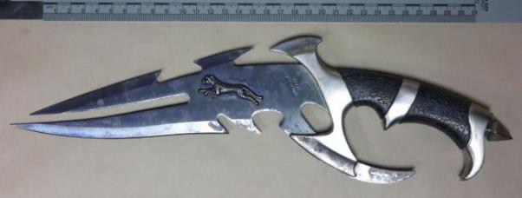


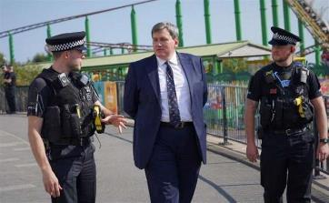
Reflecting on April to December 2021
Essex Police
Op Sceptre Week of Action: Comms around lines dismantled and people safeguarded (April)
Cuckooing training and awareness campaign: over 400 professionals trained, case study news items (May)
Operation Grip; hot spot policing: PR (Sept)
Op Raptor: six month round up (Aug) plus localised coverage of successful operations
County Lines Intensification Week: PR on results: 55 arrests, £180k in cash, 6kg drugs seized. 13 County Lines disrupted (Oct)

Slide 4

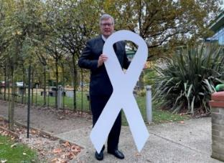

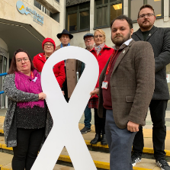
Reflecting on April to December 2021
Police, Fire and Crime Commissioner
Launch of Police and Crime Plan including commitment to reducing drug driven violence (November)
White Ribbon Day: SETDAB 16 days of action (November)
High involvement in: The Knife Angel visit, safer streets funding, safety for women, VVU grant schemes, surge funding, hot spot policing
Southend-on-Sea Borough Council
#SeeTheSigns campaign: over 18k organic video views; 31k paid for video views; 172k impressions from 17 social media posts; 3,669 click throughs to SeeTheSigns website from the social media adverts
White Ribbon SETBAB 16 days of action (November)
Safe to play safeguarding campaign – keeping those involved in sport safe (May)
Merry Muletide (Dec)

Slide 5
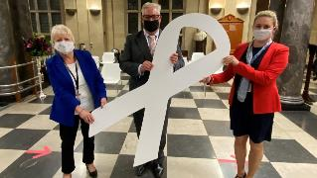
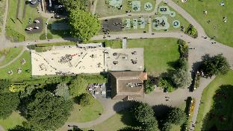
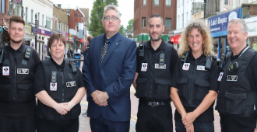

Reflecting on April to December 2021
Essex County Council
Launch of Safety Advisory Group (April)
White Ribbon Day SETDAB 16 days of action (November)
Levelling up agenda: commitments for children and families including family resilience, safety, outcomes for vulnerable children and addressing inequalities
Thurrock Council
Violence and Vulnerability Task and Finish Communications Group created
Launch of Safer Street scheme in Grays (August)
C17 gang prevention and enforcement work

Slide 6
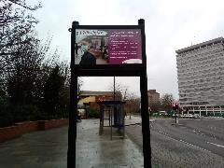

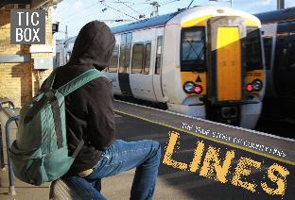

Reflecting on April to December 2021
SET Safeguarding Children Boards (SCB)
SCB Operation Henderson: 1-7 June 2021 (Multi-agency across SET) Targeted campaign to raise awareness of exploited and missing children.
Around 200,000 reach/impressions across social media
Total of 976 face-face engagements including young people (667), adult passengers (195) and train station staff, taxi drivers and businesses.
Businesses provided with posters; discussions held about how to spot signs of exploitation and missing children.
Taxi drivers and operators provided with leaflet outlining signs of sexual and criminal exploitation and how to report suspected activity to Police and Crimestoppers.
Train station staff given information about the SET exploitation e-learning tool.
SET Online Exploitation 12-18 July 2021 (quarterly social media awareness campaign)
Reach/impressions on social media across the partnership: 326,546
Facebook Lives by The 2 Johns and Brook Essex were watched by more than 4000 people; 164 views of videos and 220 podcast downloads
VVU videos Online Gaming Chat had 122 views Making new tech safe has 224 views to date.

Slide 7
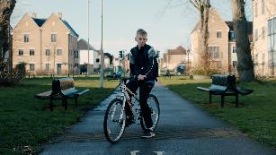
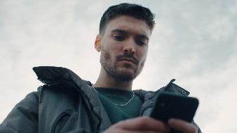
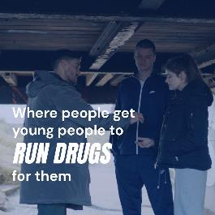

County Lines campaign
5 short films
Used the real-life experience of Essex young people
Signposted to www.essexcountylines.co.uk
Pre and post research (in Essex schools) measuring young people’s awareness of county lines.
advertising was seen by 30% of all 11–16-year-olds in Essex (most campaigns running on Facebook achieve between 4-17% recall rate)
35% of all surveyed said the ad made them want to learn more about County Lines
41% of all surveyed said the ad taught them something they didn’t know
34% of all surveyed said the ad was interesting, they wanted to know what happens next
Across the whole campaign the adverts received 2,444,894 impressions (appearances on social media feeds), with 593,724 views - a 24% view rate.
Learning informed the execution of the November rerun of the campaign.

Slide 8

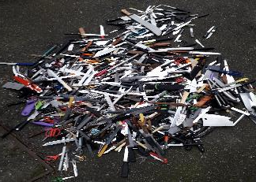
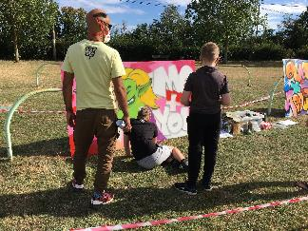
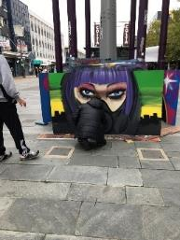
Future V&V activity January to March
Just completed the rerun of County Lines campaign – new creative based on existing assets; trialling radio ads and Spotify; current status shows Snapchat performing well, long play video up to 14.3k views (up from approx. 1.5K) 6,139 new visits to www.essexcountylines.co.uk (previous execution was 2,437) (Dec)
Knife crime awareness campaign; target audience to be parents (TBC) quotes received from market research company for benchmarking and evaluating; research scheduled with Essex Citizen Panel. Also VVU managed survey (on Smart Survey) duplicating citizen panel. Partnership piece (by April 2022)
Production of four films to showcase VVU work – for promotional purposes and web content: Fearless Futures / Knife Crime Model; Training and Development; Detached youth work; localities projects (to be completed by end March 2022)
Production of Comms Strategy for 2022 / 23 (linked to planning by Ops Board) (currently in draft form)
Support for PFCC Countywide conference (now pushed back to May 2022)
Annual Report (Mar 2022)
Develop and expand the content on www.essexvvu.co.uk (ongoing)
Proactive PR opportunities: grant allocations; funding announcements; joint operational activity; localities work; etc (ongoing)

